Slide 1
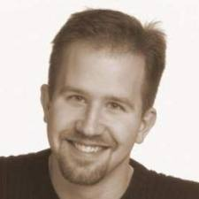
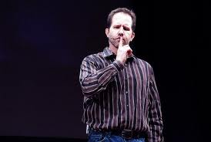
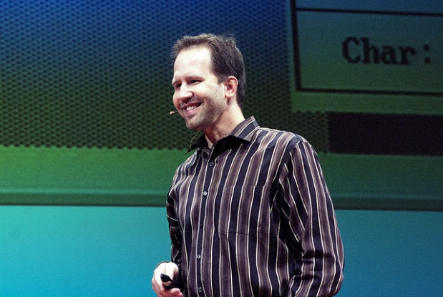

One ASP.NET – Open Source, .NET and the Cloud
Scott Hanselman
Aberdeen 12th July 2012

Slide 2
Housekeeping
Fire Alarm
Washrooms
Mobile ‘phones
Feedback
Is important to us and to Microsoft
Details will only be used to call you about the Dev Camps
http://privacy.microsoft.com/en-gb/default.mspx

Slide 3

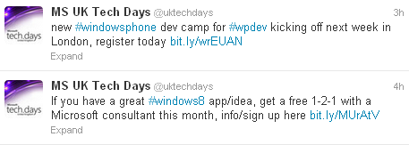
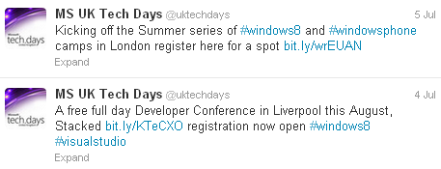
Windows 8 App Excellence Labs
Windows Phone Camps
London / Reading throughout July
Coming to Scotland August / September
http://uktechdays.cloudapp.net/upcoming-events.aspx

Slide 4


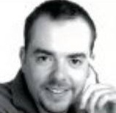
Programming Metro-style Apps Workshop
Edinburgh
Thursday 13th September
Presenter: Matthew Baxter-Reynolds (@mbrit)
Established author of many books and writes for the Guardian’s technology section
Venue TBC

Slide 5

Developer Developer Developer North
Bradford
Saturday 13th October
University of Bradford
Campus TBC
developerdeveloperdeveloper.com/north2
@dddnorth

Slide 6

DunDDD
Dundee
Saturday 17th November
University of Dundee
Queen Mother Building
One track dedicated to NoSQL
One track dedicated to Workshops
Two other tracks

